Slide 1
FINANCIAL SERVICES
SUB CODE:20UCO4AC8
N.MOHAMED ASHIK
Assistant Professor
Department of Commerce

Slide 2
UNIT-1

Slide 3
UNIT-1

Slide 4
Definition of Financial Services
The financial service industry is defined as, "The collection of organisations which intermediate and facilitate financial transactions of individual and institutional investors from their resource allocation activities through time".
Features of Financial Services
• Variety of Services: (Different people-different need)
• Intangible: Measuerd in quality, attractiveness, feedback) • Massive Branch Network: Local, National, International
customers) • High Personnel Costs: (Highly labour intensive, use of
technology)
* Information-based: (Information based industry)
• Customer Oriented: (Responsibility-protect customer's
пістез
• Direct sale: (No middleman)

Slide 6
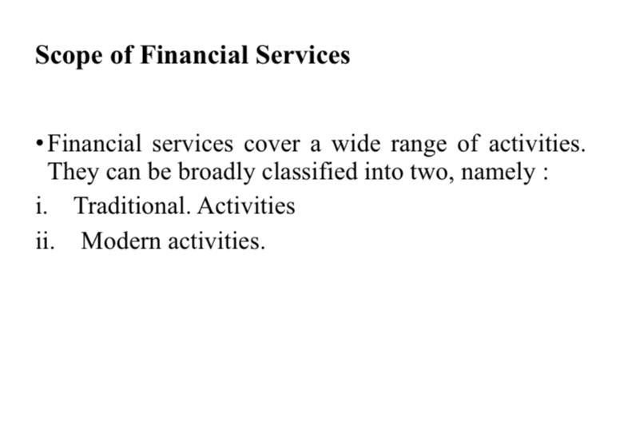

Slide 19
